Slide 1
Forming an Extension District
Board Leadership Series

Slide 2
What does districting mean to you?
    The benefits and concerns of districting…
Notes:
Open the presentation with a brief discussion regarding the benefits and concerns (both perceived and realistic) of districting. Utilizing the “What districting means to us” worksheet, have board members list what they see to be both the benefits and concerns of districting. Referring to the “What districting means to us” supplement, assist the board members in establishing a comprehensive list. Include all issues board members suggest but be sure all items that appear on the supplement are addressed as well.

Slide 3
Common misconceptions
  With more counties, agents will be stretched more thinly
  County citizens will lose control of extension programming
  If a county becomes part of a district, its county office will close
  Districting will cause us to lose our county fair
  Taxes will increase as a result of the creation of an extension district
Notes:
There are several common misperceptions about districting (If some of these were mentioned in the previous discussion, be sure to note that). Some of these are:
With more counties, agents will be stretched more thinly – Actually, it should be just the opposite. Instead of being responsible for multiple areas of programming, agents are instead able to concentrate on a specific area of program focus.
County citizens will lose control of extension programming – Even in a district, local governance remains extremely important. Each county in the district is represented by four district governing body members, all of whom are elected by the residents of that county.
If a county becomes part of a district, its county office will close – This is a decision that emerging districts will have to make based on changing needs they face. Currently, all newly formed districts have chosen to keep all their county offices open.
Districting will cause us to lose our county fair – While K-State Extension is highly involved in county fairs, they are generally run by local fair boards or associations. In the existing districts, individual county fairs have remained and the district has continued to provide them support.
Taxes will increase as a result of the creation of an extension district – As mentioned earlier, the members of the districting governing body are representatives elected by county citizens. They, too, are tax payers and good stewards of taxpayer money. In addition, after the first couple of years of a district’s existence, as efficiencies are implemented, the mill levy has actually dropped in several districts.

Slide 4
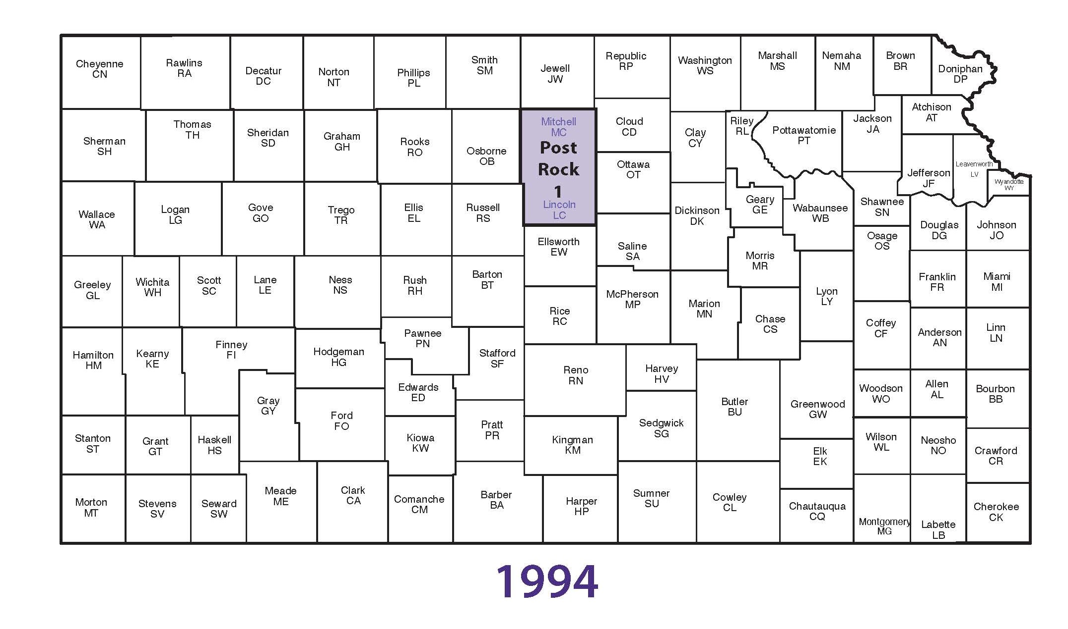
History of Districts
Notes:
Extension districts continue to form. The first district, Post Rock, was formed in 1994 by Mitchell and Lincoln Counties. Other counties are discussing districting and working to create the right partnerships.

Slide 5
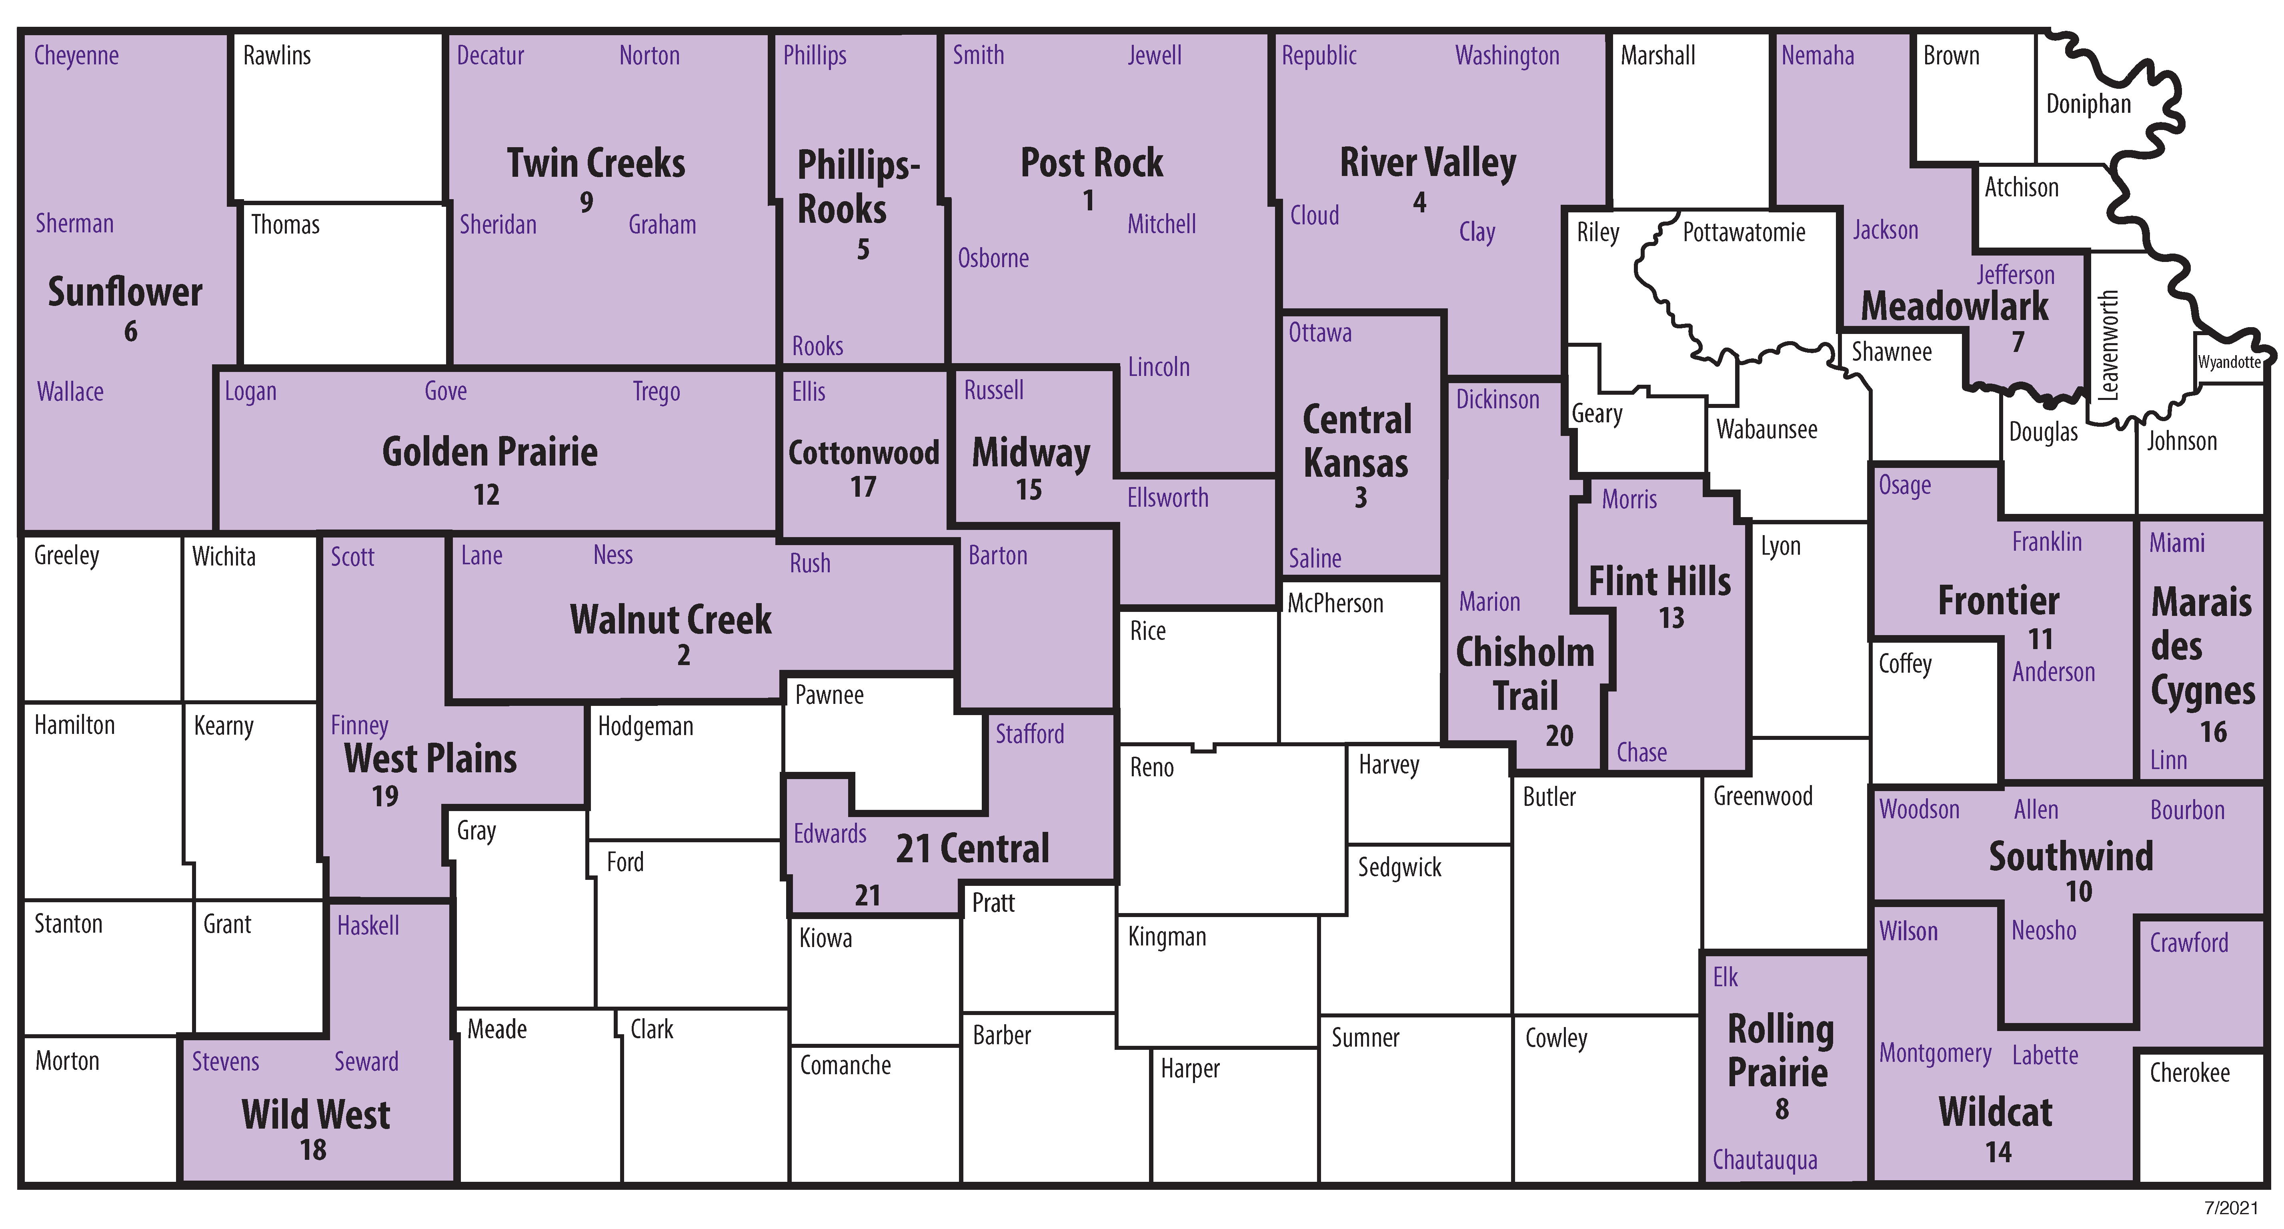
History of Districts
Notes:
Extension districts across Kansas as of 2021. 21 Central Extension District was the most recent district, formed July 1, 2021.

Slide 6
Why district?
Effectiveness
Relevance
Efficiency
Sustainability
Notes:
Why is districting an option that is being considered by these counties? There are four primary reasons (all addressed in our previous discussion):
Effectiveness: Kansans have expressed their desire for more in-depth knowledge on subject matter from our agents, and districting can help us to provide that. As a part of a district staff, agents no longer have to cover several program areas and instead can dedicate more time and energy to a specific area of program focus. At the same time, agents have access to more resources and support from one another as they work together on a larger staff.
Relevance: Closely tied to effectiveness, the need for K-State Extension to establish itself as a relevant resource for the Kansas resident is clear. This means we have to make sure we’re on the cutting edge in dealing with the contemporary and high priority issues affecting the citizens we serve. Agent’s development of more in-depth knowledge in specific areas of focus can allow them to stay on that cutting edge and ensure their relevance to district residents.
Efficiency: Changing demographic situations, including declining populations in some Kansas counties, have led to the reality that some counties can afford only one agent. These agents are left with an extremely heavy load: addressing the various programming areas. In addition, many counties (which generally provide the majority of the Extension Council’s operating budget) have not been able to allocate sufficient funds for personnel and operation costs. Merging operations can lead to financial efficiencies and free up more time for programming as counties pool both financial and staffing resources. While agents may have to travel a bit more, they are reaching a larger audiences with their programming, making the system more efficient.
Sustainability: Also addressing the financial aspect of operations, districting helps to assure the sustainability of K-State Extension services in a county. By establishing a taxing authority, the extension district gains more flexibility to meet the district’s personnel and operational needs and ensure continued programming.

Slide 7
Forming a district partnership
Staff support
Public Support
Enthusiasm
Willing and Engaged
Exhibits similar characteristics
Focuses on the goal of success
Notes:
What is needed for the districting process? Three main things: support, staff and enthusiasm.
Staff support: While a district staff of seven or eight agents (or more) is ideal, it is not necessary. In the districts that exist today, staff sizes range from two to fourteen agents. Instead, what is most important is a staff that is ready to work together to form a district and is willing to identify and fill any holes in district programming. The goal of a successful district should be shared by all. Staff members should support one another and willingly pass on past responsibilities to the agent whose area of program focus is best suited to accept those responsibilities.
Public support: For a district to be formed, public support is essential. The district has to be approved by county commissioners, so there should be sensitivity toward public misconceptions and opinions about the district. Reasons for forming the district should be made clear to all county residents. Changes that will come about as a result of the district also should be carefully communicated. Avoid surprises that could catch residents off guard and create resentment.
Enthusiasm: Equally important is enthusiasm. The formation of a district brings many changes and adjustments, and an enthusiastic staff and board is critical. Individuals involved should be ready to positively address challenges and make the changes needed for a successful process. An important aspect of districting is partnerships that are formed. Keep in mind these qualities when selecting these partnerships.
Willing and engaged: As was noted previously, successful district formation requires willingness and enthusiasm from the staff as it works through the process. Any county interested in forming a district should keep these qualities in mind while selecting district partners.
Exhibits similar characteristics: The district process tends to be easier when participating counties have similar characteristics (i.e. geographic area, population size, economic situation, etc.). However, sharing such qualities is not necessary. With effort and patience, partnering counties can overcome differences to form a successful and dynamic district.
Focus on the goal of success: Perhaps the most important aspect of forming a district is a focus by all staff members on the goal of success. Forming a district is a whole-team effort and requires full participation. For a truly successful district partnership, all partners must be willing to work and adapt as necessary to achieve it.

Slide 8
Is Districting for you?
Are we as effective as we should be in meeting the needs of our county residents?
Are we as relevant as we should be in our delivery of cutting edge information to address local issues?
Are our services and efforts sustainable in their current format?
Do we have the political and public support necessary to pursue districting?
Notes:
Counties considering districting and wanting to know if it is the right move should first ask some questions:
Are we as effective as we should be in meeting the needs of our county residents? Being effective means that we are meeting the needs of residents at the depth they want and in the format they can best access. As you ask yourself whether your county is as effective as it should be, examine the method used to evaluate effectiveness. Is it the most representative evaluation under the circumstances?
Are we as relevant as we should be in our delivery of cutting edge information to address local issues? The question of relevance goes past simply meeting information delivery needs of county residents and instead addresses the ability to be knowledgeable messengers of research produced by K-State Extension. To be truly relevant, agents should constantly update themselves on current research and relaying that information in an easy-to-understand format to address the most important needs and issues Kansas residents face.
Are our services and efforts sustainable in their current format? It is necessary to determine whether or not you can be confident county services and efforts are sustainable. Looking at current situations, each county should evaluate its financial security and ability to provide sufficient funds for operational and personal costs, both now and in the future.
Do we have the political and public support necessary to pursue districting? Support from public and political leaders is imperative to the districting process. Your county needs to determine if that support is there. If not, can you rally the support needed. The answers to these questions-or-simply the desire to ensure relevance, sustainability, and existence for your future-should help lead you to determine whether or not districting is for you.

Slide 9
What are your resources?
Support from K-state
Existing districts
Notes:
One important thing to remember when considering districting: You are not alone. Numerous individuals can guide you through the process.
Support from K-State: Your regional director will work closely with you as you complete the administrative steps and can help answer many of the questions you may have regarding your unique districting situation. In addition, other on-campus support staff, including the associate director for Field Operations, can also facilitate formation of your district.
Existing districts: The best people to talk to are those who have already gone through the districting process. Take the time to talk to staff and board members in existing districts. Find out why they initially chose to district. What has it done for them? What do they wish they had done differently? Do they have any advice on how to make the process the best possible?

Slide 10
Any Questions?
Notes:
Close the presentation by handing out these documents: “Forming an Extension district” brochure, “Proposed timeline for Forming an Extension District” and “Are we ready to district?”. Open the discussion to any questions or additional comments.

